Slide 1
DATA 606 Capstone in Data Science
TELCO CUSTOMER CHURN PREDICTION
Team Members
Harshini Akkapally - RK84133
Sravani Ravulaparthi - PN88693
Akhila Amaranayani - UD82090
Under the guidance of Professor
Dr. Ozgur Ozturk

Slide 2
TELCO CUSTOMER CHURN PREDICTION
Customer Churn/Attrition occurs when consumers stop using a service or quit a company
Retaining customers is important for any business to boost revenue
Cost of acquiring a new customer is five times more than that of retaining an existing customer
Machine learning offers efficient ways to identify the root causes of churn as well as prescriptive tools for addressing it.
We Identify behavioral patterns of customers who have already stopped using the services
Compare the behavior of the current consumers to these patterns to find potential churners

Slide 3
DATASET
Open-source IBM Dataset used in telecommunications sector to track customer turnover.
It was initially published in the IBM Community and now available on Kaggle website
source: https://www.kaggle.com/datasets/blastchar/telco-customer-churn
The dataset contains 7,043 customers and 21 variables.
It includes data on each customer’s demography, the environments of internet connection and related support, contract terms, billing and payment methods, and the amount charged.

Slide 4
VARIABLES IN DATASET
The data set includes information about:
Target Variable – ‘Churn’, Customers who left within the last month
Other Variables include,
Services that each customer has signed up for – phone, multiple lines, internet, online security, online backup, device protection, tech support, and streaming TV and movies
Customer account information – how long they’ve been a customer, contract, payment method, paperless billing, monthly charges, and total charges
Demographic info about customers – gender, age range, and if they have partners and dependents

Slide 5
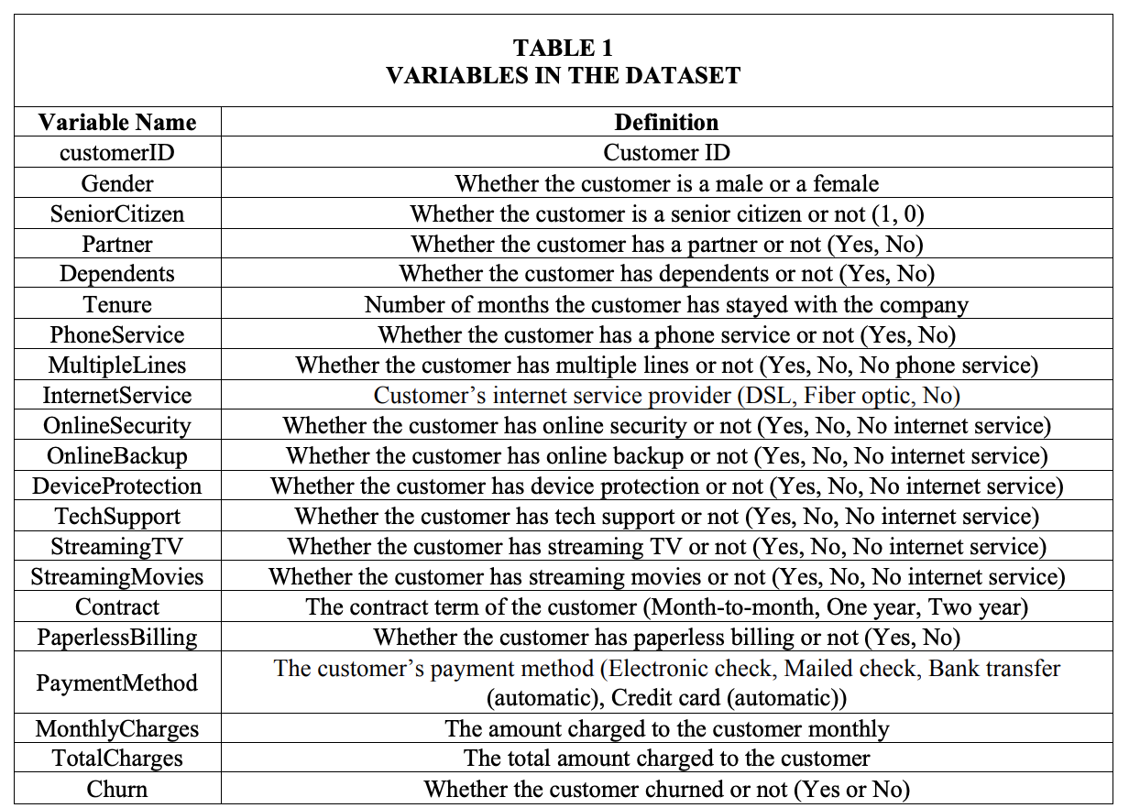

Slide 6
Literature Review
Most popularly used algorithms in this period were traditional ones such as Logistic Regression, Decision Tree, and Artificial Neural Network
Eria and Marikannan (2018) reviewed more recent articles published from 2014 to 2017. Their review showed that traditional machine learning algorithms were still dominant in this period.
Specifically, the most frequently used classification algorithms in this period were SVM (Support Vector Machine) and Neural Network, followed by Decision Tree, Naïve Bayes, and Logistic Regression
In the analysis of Lee et al. (2017), Neural Network achieved the highest accuracy, followed by Decision Tree and Logistic Regression.
Patil et al. (2017) showed that while Ensemble Learning algorithm XGBoost showed superior accuracy than SVM and Random Forest.

Slide 7
REFERENCES
[1] Kimura, T. (2022). Customer churn prediction with hybrid resampling and ensemble learning. Journal of Management Information and Decision Sciences, 25(1), 1-23
[2] Wang, Xing & Nguyen, Khang & Nguyen, Binh. (2020). Churn Prediction using Ensemble Learning. 56-60. 10.1145/3380688.3380710.

Slide 8


